Slide 1

Fruitful Minds Week 6 Course Review Activity

Slide 2
2. Food
Labels
3. Physical Activities
1. Food Groups
6. Food Pyramid
4. Vitamins
5. Nutrients
8. Physical Activities
7. Salt
9. Fiber

Slide 3
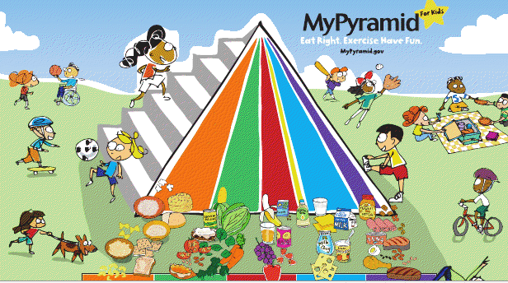
1. We can categorize food into six groups. Three of them are grains, oils, and fruits. What are the other three food groups?

Slide 4
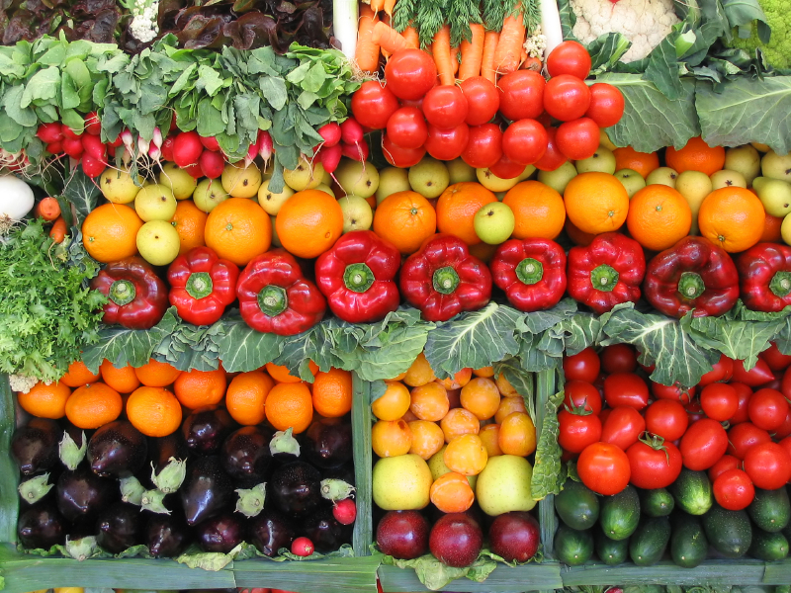

1. Ans: Vegetables, diary, and meat

Slide 5
2. How can you tell how much “energy” a food product contains?

Slide 6
2. Ans: You can tell how much “energy” a food product contains by looking at how much calories it has (as shown in the nutrition label).

Slide 7
3. Running is a type of
a.) strength training exercise.
b.) stretching exercise.
c.) aerobic exercise.

Slide 8
3. Ans: Running is a type of
a.) strength training exercise.
b.) stretching exercise.
c.) aerobic exercise.

Slide 9
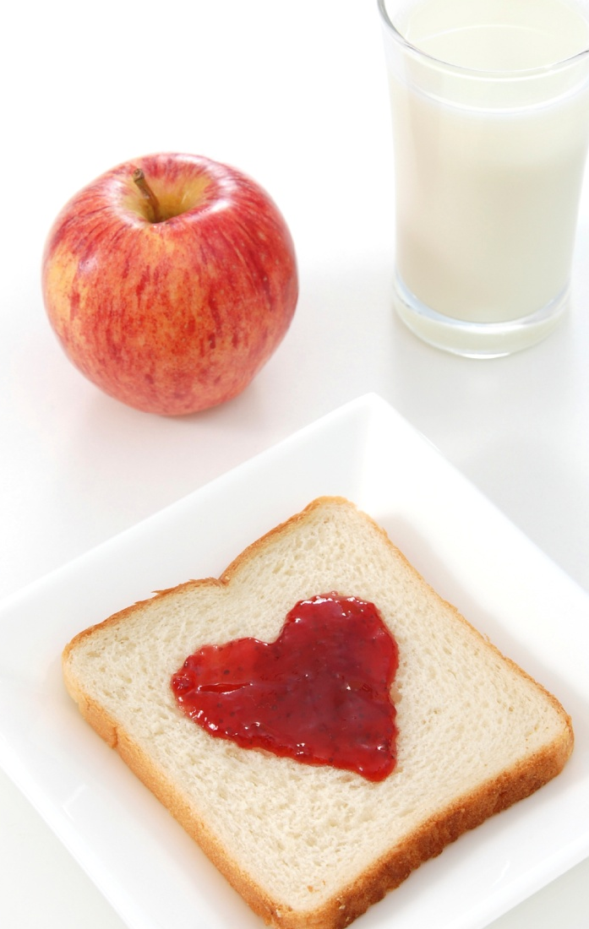
4. Name one vitamin or mineral and how it helps your body.

Slide 10
4. (multiple answers are accepted; answers are not limited to the following)
Vit A: gives you healthy skin, eyes, and hair
Vit D: bone and teeth development
Vit C: helps maintain hard bones and teeth; prevents infections, colds, fatigue and stress
Calcium: builds bones and teeth
Iron: important for the formation of red blood cells

Slide 11
5. The nutrients we need can be categorized into different groups. Which two nutrients are missing from the list below?
Protein, vitamins, mineral, water, ___?____, ___?_____

Slide 12
5. Ans: The nutrients we need can be categorized into different groups. Which two nutrients are missing from the list below?
Protein, vitamins, mineral, water, carbohydrate, fat

Slide 13
6. True or false—“The stripes of the Food Pyramid represent different food groups. The thicker the stripe of a certain food group, the more important it is for our body.”

Slide 14
6.Ans: True or false—“The stripes of the Food Pyramid represent different food groups. The thicker the stripe of a certain food group, the more important it is for our body.”
False – If a stripe for a certain food group is thicker, it does not mean it’s more important, because all food groups are important! If a food group has a thicker stripe, it means we should eat more of it comparing to a food group that has a thinner stripe. For example, we should eat more fruits comparing to oil because the stripe that represents fruit is thicker.

Slide 15
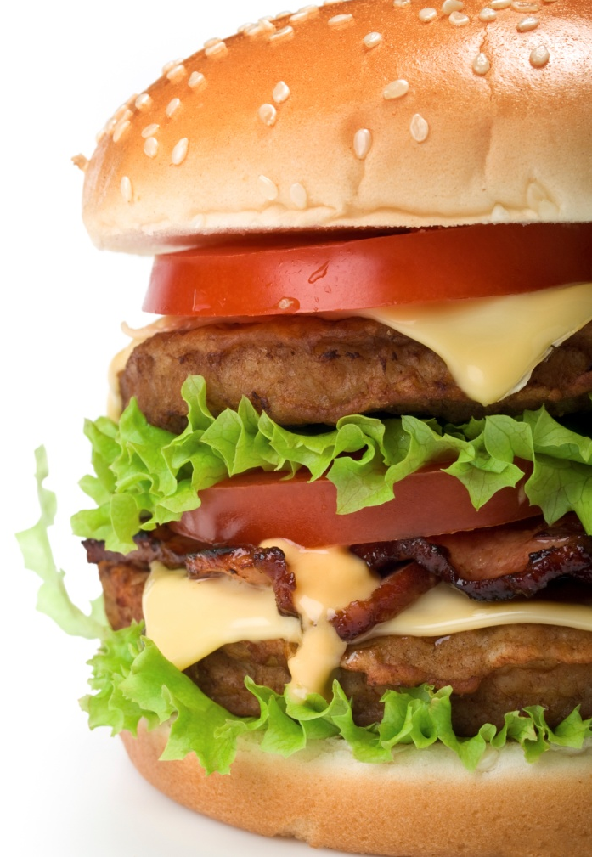
7. By looking at a food label, how can you determine if a food product contains too much salt?

Slide 16
7. Ans:
Milligrams of salt ≤ calories
(For example, if a product contains 500 calories, the amount of salt should be less than 500 milligrams.)

Slide 17

8. What are two reasons why exercising is good for you?

Slide 18
8. Ans: (multiple answers are accepted; answers are not limited to the following)
1. prevents weight gain (obesity) and other related diseases
2. helps you focus and do better in school
3. exercising is fun
4. makes you a stronger person

Slide 19
9. Give one example of a food that is rich in fiber, and give one reason why someone should eat food that contains more fiber.

Slide 20
9. Ans:
Fruits/vegetables and whole grains are rich in fiber.
Benefits of fiber: prevents constipation, lowers the risk of certain diseases, helps with digestion, makes you feel full faster…

